Slide 1

Solar Power Regression
GROUP 3
Snehal Gawade Monika katre
Sargam Thakre Krishna kanth
Anil kumar Abhishek gowda

Slide 2



Solar Power Generation Prediction
Data Science Team
Data Analysis
Solar Power Generation
Experienced professionals dedicated to harnessing the power of data for renewable energy solutions.
Advanced algorithms extract meaningful insights from complex data.
Accurately predicting energy output to optimize renewable energy resources.

Slide 3


Project Overview
Project Goal
Methodology
Accurately predict daily solar power generation using machine learning.
Advanced machine learning algorithms and historical data (solar power, weather) will be used to create a predictive model.

Slide 4
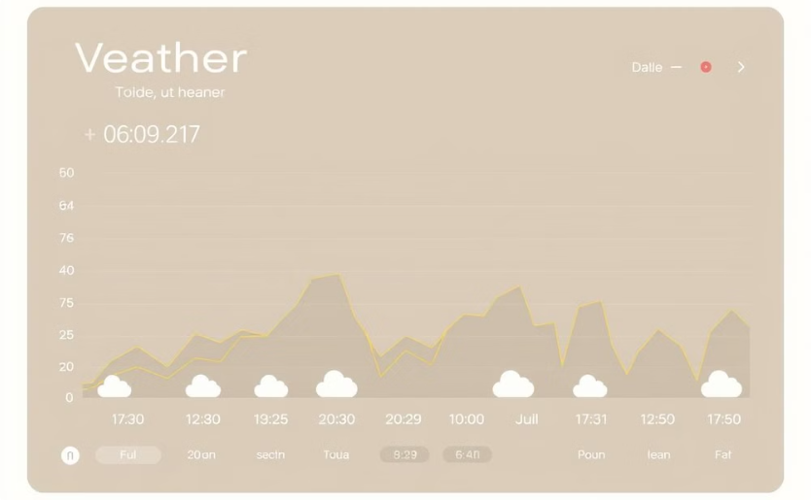

Dataset Overview
Features
Target Variable
distance to solar noon, temperature, wind direction, Humidity, Wind Speed, Visibility, sky cover etc.
Power Generated

Slide 5
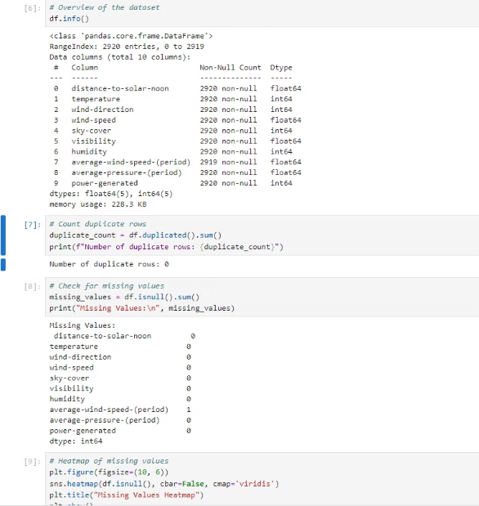
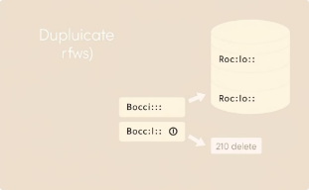
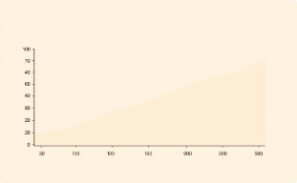
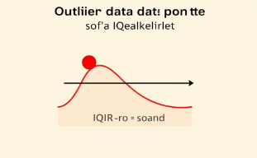
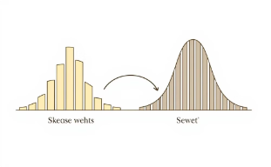
Data Preprocessing
Duplicate Removal
Missing Value Imputation
Duplicates were removed to ensure data integrity and avoid bias.
Missing values were handled using median imputation to maintain data distribution.
Outlier Handling
Log Transformation
Outliers were capped using the IQR method to mitigate their impact.
Log transformation was applied to skewed distributions.

Slide 6
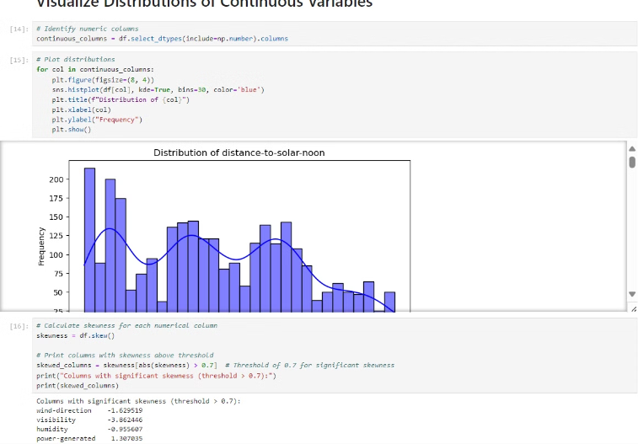
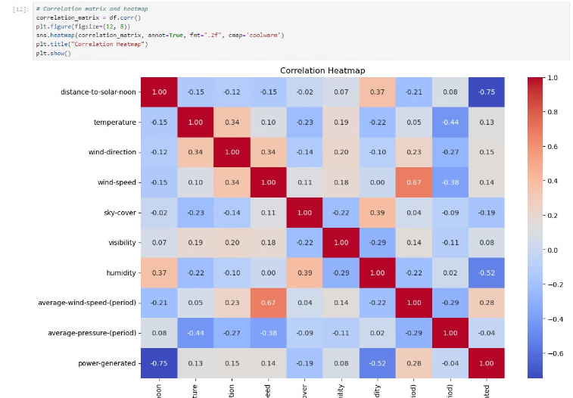
Exploratory Data Analysis
Findings
Visuals
Correlation analysis of features. Skewness and transformation applied to correct distributions. Pairwise relationships using scatter plots and pairplots.
Correlation heatmap, Pairplot or scatterplot example.

Slide 7
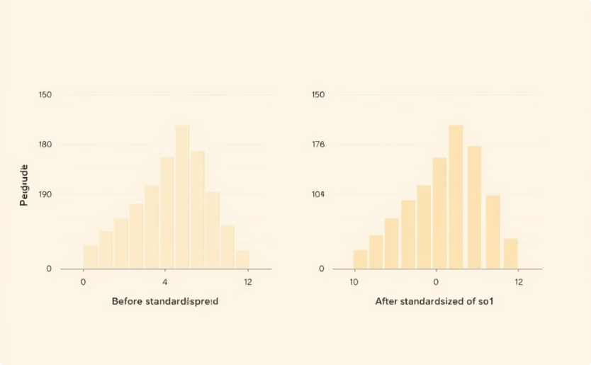
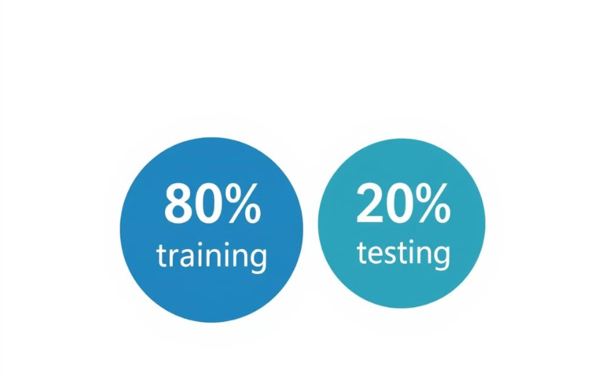
Feature Engineering
Standardization
Data Splitting
Standardized numerical features using StandardScaler.
Split data into training (80%) and testing (20%) sets.

Slide 8
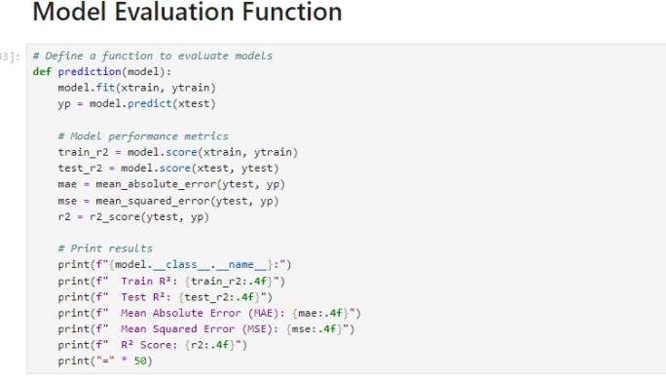
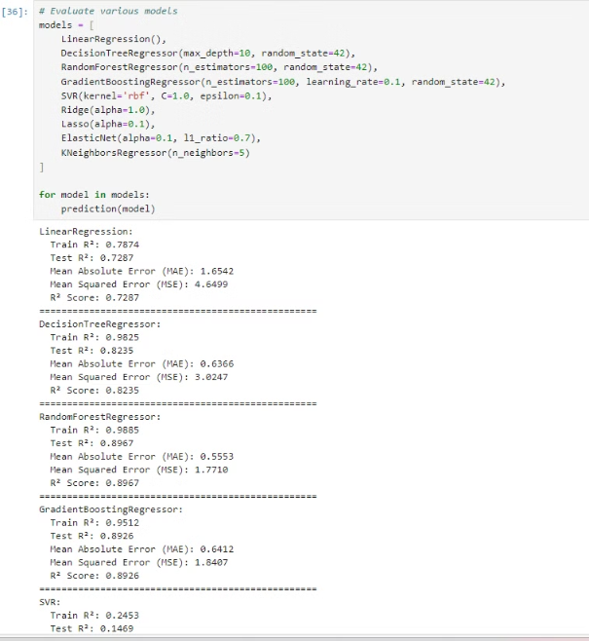
Model Evaluation
Baseline Models Evaluated
Metrics Used
Linear Regression, Random Forest, Gradient Boosting, Decision Tree, etc.
R² score, Mean Absolute Error (MAE), Mean Squared Error (MSE).

Slide 9

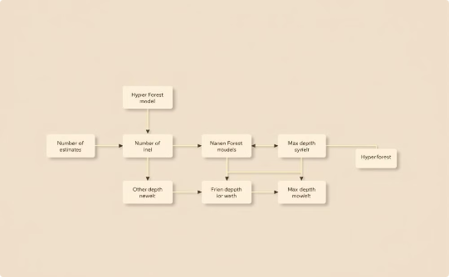
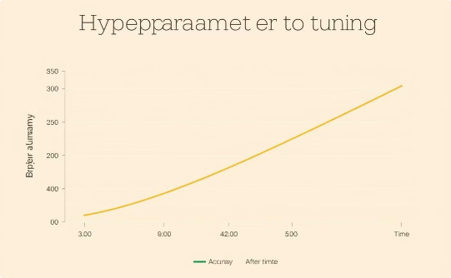
Hyperparameter Tuning
Method
Hyperparameters Tuned
Outcome
RandomizedSearchCV for Random Forest.
Number of estimators, max depth, minimum samples split, etc.
Best Random Forest model selected.

Slide 10
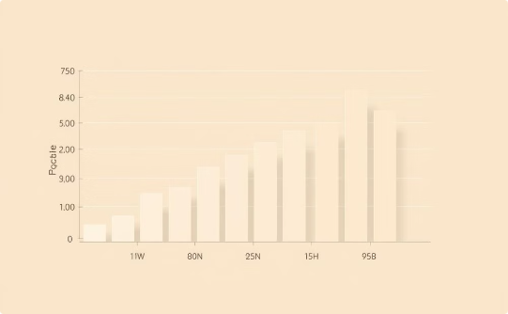
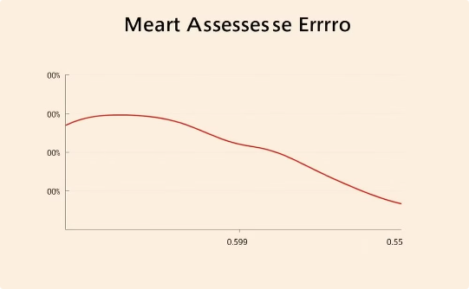
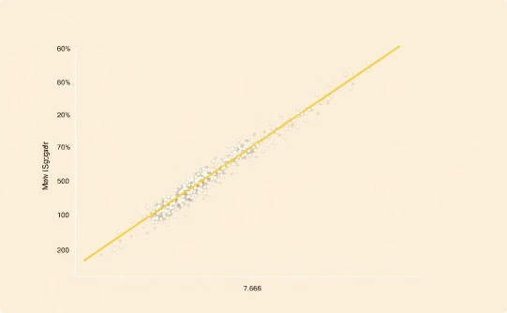
Final Model Evaluation
Test R²: 0.95
MAE: 0.598
MSE: 1.6266
Strong model accuracy
High prediction precision
Excellent model fit

Slide 11
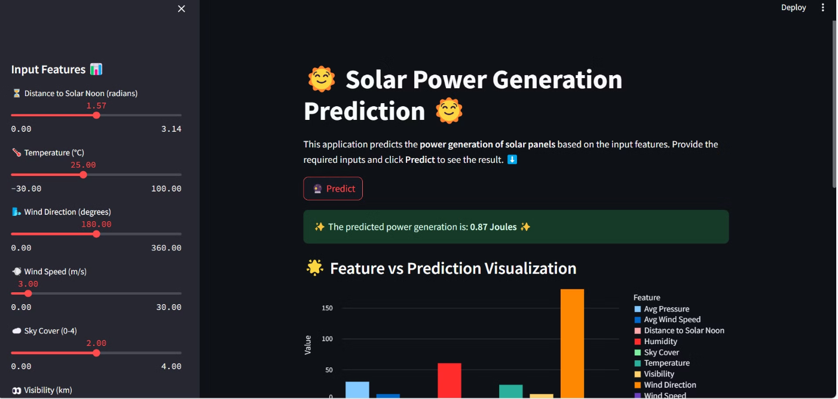
Deployment
Streamlit App: Interactive prediction interface for solar power generation. Features sliders for user input and dynamic visualization.

Slide 12
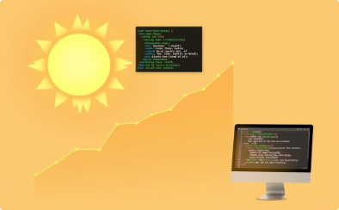



Conclusion and Future Scope
Highly Accurate Prediction Model
User-Friendly Prediction Interface
Expanded Dataset for Enhanced Accuracy
Real-Time Weather Data Integration
Developed a highly accurate model for predicting solar power generation.
Successfully deployed a user-friendly prediction interface using Streamlit.
Integrate real-time weather data for more dynamic and responsive solar power predictions.
Expand the dataset to improve model generalization and accuracy across diverse weather conditions.

Slide 13
Thank You!
We appreciate your time and attention.

